Slide 1
Presentation by - Surabhi Pandey
Age & Gender Impact On Cardiovascular Disease Prediction In Indian Population Using Machine Learning
PRN: 23050202595
Guided by – Dr. Vandana Shivaraj (Qollabb Edutech)

Slide 2
Objective
Primary Goal: To determine which machine learning model can most accurately predict cardiovascular disease (CVD) risk using available clinical data from a sample of the Indian population. The result will indicate whether the patient has heart disease or not. This machine learning model can help in early detection and prevention of CVD which are crucial for reducing mortality rates and improving patient outcomes in India.
Secondary Goal: The project also aims to offer preliminary insights into how the demographic variables such as age and gender influence the model result and its accuracy.
Motivation: According to the research published by Bisma Jan et al. (2024) and titled “Cardiovascular Diseases Among Indian Older Adults: A Comprehensive Review”, in India, the risk of heart disease increases with age, from 22% in people aged 45-54 to 38% for those 70 and older. Women (32%) are more likely to have heart disease than men (26%).

Slide 3
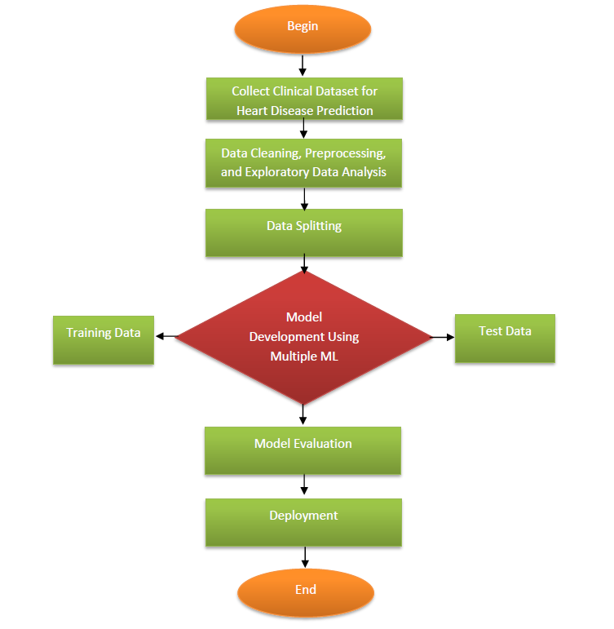
Methodology
Data Collected:
This heart disease dataset was obtained from a multispecialty hospital in India. This dataset consists of 1000 subjects with 12 features commonly observed factors in heart disease cases such as cholesterol, blood pressure, chest pain, blood sugar, etc. This dataset is valuable for early-stage heart disease detection and for building predictive machine learning models to advance research in this area.
Dataset Citation: Bhanu Prakash Doppala and Debnath Bhattacharyya, (2021), “Cardiovascular_Disease_Dataset”, Mendeley Data, V1, doi: 10.17632/dzz48mvjht.1

Slide 4
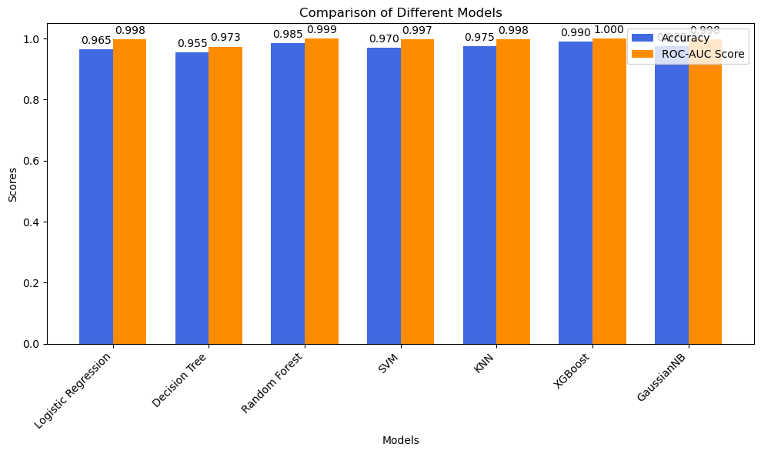
Project Outcome
The study demonstrated seven classification algorithms and the models were evaluated based on the accuracy and ROC-AUC score:
XGBoost is the best-performing model in both accuracy and ROC-AUC score, making it the top choice for this task.
Random Forest, KNN, and SVM also perform well, though slightly behind XGBoost.

Slide 5
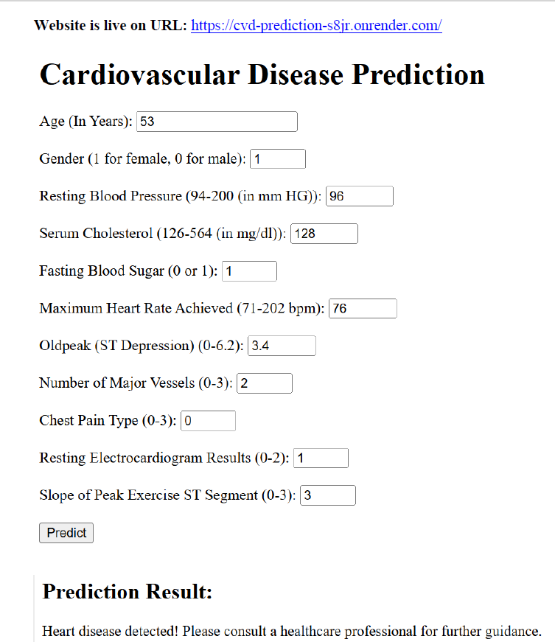
Model Deployment

Slide 6
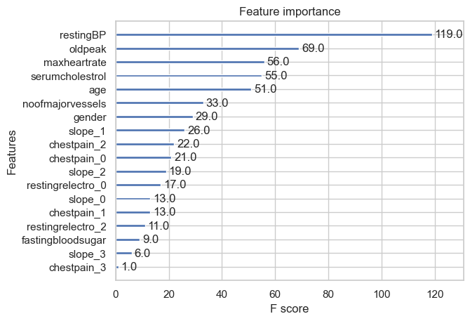
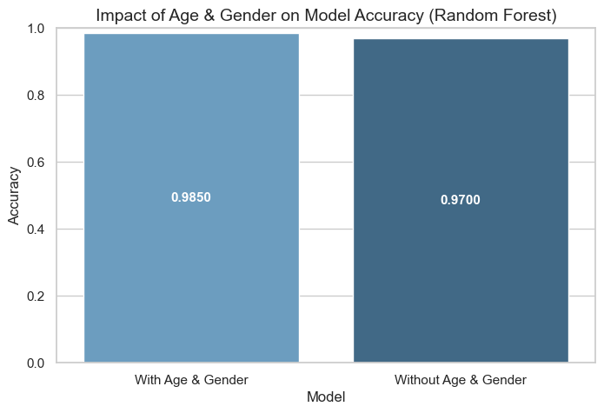
Feature Importance (Age & Gender)
Using Feature Importance from XGBoost Model
Impact of Age and Gender on Model Accuracy (Random Forest)

Slide 7
Final Conclusion:
It is recommended to keep age and gender as part of the feature set for any future models predicting heart disease, as they provide valuable context that improves accuracy.
This machine learning approach successfully predicts cardiovascular disease and is a helpful tool for early diagnosis, which could help prevent serious heart conditions.
The predictive insights from the model could contribute to more personalized healthcare strategies, helping identify individuals at risk of heart disease more effectively.

Slide 8
Scope for Future Study
Incorporating Additional Demographic and Lifestyle Factors
Exploring Deep Learning Models for Better Prediction
Developing Region-Specific Models
Integrating Real-Time Monitoring with Predictive Models
Expanding the Dataset to Include Genomic and Medical Data

